Slide 1
RPS – FORMULARY COMPLETE
Sprint 4 Planning

Slide 2
Agenda
Sprint 3 Deliverables’ Status
Sprint 3 Retrospective
Sprint 3 metrics
Project Status
Sprint 4 Plan
Sprint 4 Implementation Plan A
Sprint 4 Implementation Plan B (Contingency)
Change Requests
Risks & Impact
Questions?

Slide 3
Sprint 3 – Deliverables’ Status
User Story | Summary | Status | Remark
FC 212, 213 and 214 | • Refactoring for Pharma Press - Drug Services • Refactoring for Pharma Press - Search Services • Refactoring for Pharma Press - Admin Services | Completed Completed Completed | All changes have been done and are awaiting review
FC 215, 216 and 217 | • Refactoring - Search Module • Refactoring - Local Records Listing • Refactoring - Local Records Creation | Incomplete 50% Completed Completed | “Futures” implementation. All changes are awaiting review
FC 218 | • Monograph - Template Implementation | Incomplete | Header and footer template segregation is complete. James to render BNF content in templates
FC 219 | • Data Model | Completed | Under Review

Slide 4
Sprint 3 – Deliverables’ Status
User Story | Summary | Status | Remark
FC 220 | • Logger Implementation | Incomplete 60% | Completed for 2 services. Will be delivered in next 2 days
FC 221 | • Exception Handling Server Side Client Side | Incomplete 50% | Server side exception handling has been completed for Admin.
FC 223 | • Object Mapper Changes | Incomplete 30% | This is pending implementation at web App
FC 222 | • Scala Unit Tests | Incomplete 50% | Completed for Search. Pending for Admin and Drug (Services)
FC 10 | UI Changes for : • Monograph • Notes and Records Page • Generation of TOC • Search Page | Pending | The previously delivered functionality is to be restored, and look and feel updated to the latest.

Slide 5
Sprint 3 – Deliverables’ Status (Web design)
User Story | Summary | Status | Remark
FC230 | • Monograph Changes | Complete | Awaiting Feedback The web design is in progress. Awaiting Feedback
 | • Export formulary content | Complete
 | • Managing Work queue | Complete
 | • Edit Local content (Records) • Edit Content Notes | Complete
 | • Edit content: formulary status | incomplete
 | • View changes across BNF versions | Complete

Slide 6
Sprint 3 – Goals and status
Goal for the Stabilization Sprint | Status | Remarks
All common dependencies factored out, and everyone on the same code base | Completed
All projects building automatically on check in to Github | In Progress | This activity is with James
Daily automatic deployment of projects to Azure | Completed
Up to date ElasticSearch on Azure | In Progress | Pending for Admin Module
Web-app re-factored to controller, Service, with dependency injection | In Progress FC 212- 218 | Nearing completion. Checked in code is under review
Unit Tests for controllers and services | In Progress FC-222 | Pending Admin and Drug Services
View templates with common codes extracted into separate templates | Completed
Drug monograph template re-factored with separate templates for each pot | In Progress
Using Json Format (removing Object Mapper | In Progress | Nearing completion.

Slide 7
Sprint 3 – Retrospective
What Worked
Visit by Ian, Harvey and James.
Frequent check-ins, and prompt code reviews.
Refactoring Activities.
What can be improved
Deliverables.
Peer review before checking-in code.
Ensuring the issues identified in earlier review are not repeated.
Discussion of design before working on a new module.
Web UI design to be finalized as early as possible in the sprint.
Logging time in JIRA
Questions on functionalities to be asked earlier in the sprint.

Slide 8
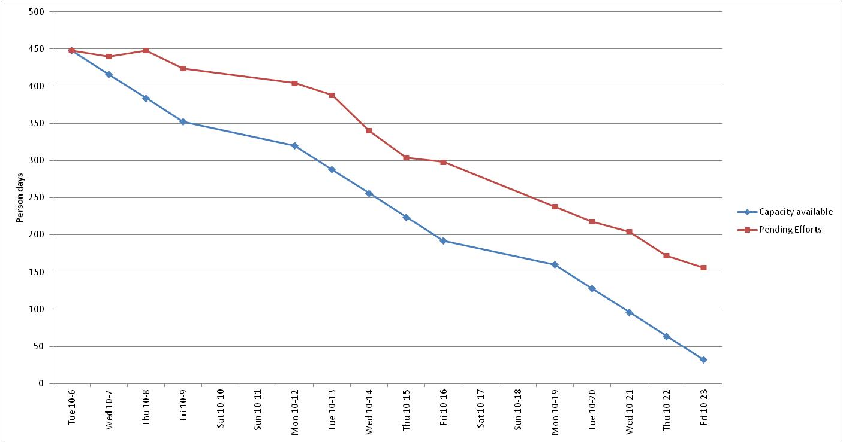
Sprint 3 – Metrics
Story points planned - 56 SP
Story points delivered 30 SP

Slide 9
Overall Project Status
Project Deliverables | Plan of Delivery | Revised Plan of Delivery | Remarks
User Accounts | Sprint 1 | Sprint 5 | Integration with SAMS is still pending.
Search Module | Sprint 2 | Sprint 4 | Basic Search module had been delivered in sprint2. Re-factored Search module is being tested. Monograph page is not completed so far
Edit the content: formulary status | Sprint 2 | Sprint 5 | Existing code to be changed to point to ES.
Edit the local content | Sprint 2 | Sprint 4 | The add/update/delete for local content and notes had been delivered earlier. Post code refactoring, functionality will be restored within first week of sprint 4
Edit Notes | Sprint 2 | Sprint 4

Slide 10
Overall Project Status contd.
Project Deliverables | Plan of Delivery | Revised Plan of Delivery | Remarks
Monitor content changes: approval /workflow | Sprint 4 | Sprint 4 | No Change in overall project Plan
Monitor content changes: audit | Sprint 4 | Sprint 5 | These reports are still under discussion
Export formulary content | Sprint 4 | Sprint 4 | No Change in overall project Plan
Admin Module | Sprint 4 | Sprint 5 | Web design is to be finalized
Drug Comparison | Sprint 5 |  | De-scoped (Comparison across drugs still in scope)
Annotation Search | Sprint 5 |  | De-scoped
View Changes across BNF versions | Sprint 5 | Sprint 4 | Reduced scope
Migration Activity | Sprint 3 onwards | Sprint 5 | Ian to visit in November and bring this to closure

Slide 11
Sprint 4 Plan
Tasks | Details | Remarks
Continue work for Refactoring/ code quality/ unit test | Scala tests are to be implemented for Services “Futures’ implementation Removal of Object Mapper | The aim is to finish of this work latest by 30th October.
Restoring earlier delivered functionality | Search functionality, Table of Content , and admin module (records and notes) All updated with latest look and feel changes. | Need sign off on web design as soon as possible.
Removing all session state
Rendering BNF content correctly. | Monograph Changes | James is looking at this.
Creating Access Management micro-service and linking site to it | This service would supply mock authentication to the FC till a decision is taken on SAMs

Slide 12
Sprint 4 Plan
Tasks | Details | Remarks
Managing Work queue | New Functionality. Monitor content changes: approval/workflow . | The web design is under review Need to be signed off before 30th Oct.
View Changes across BNF versions | New Functionality. Screen to provide user an option to view changes across BNF versions | The web design is under review Need to be signed off before 30th Oct.
Export Formulary Content | New Functionality. Report to view and export details of formulary content, based on different parameters. | The web design is under review Need to be signed off before 30th Oct.

Slide 13
Sprint 4 Plan - A

Slide 14
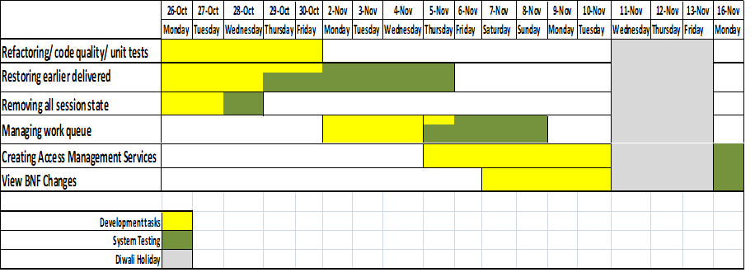
Sprint 4 Plan – B (contingency)
Plan B does not include the export formulary content.
This plan will come into play if there is any deviation in planned deliverables for week ending 30th October.

Slide 15
Definition of Done
Definition of Done will be the System Test Cases as approved by RPS

Slide 16
Change Requests
Not Applicable

Slide 17
Risks & Impact
Turnaround time for clarifications – Clarifications if not answered at the earliest could impact on the deliverables/ cause rework.
Mitigation
Rave to proactively share list of clarifications with RPS periodically.
RPS to reply to clarifications with a one day turnaround time to minimize the impact on the deliverables and avoid rework.
Contingency
Rave to continue development making assumptions
Impact
Idle Time, Budget and Schedule

Slide 18
Questions?

